Slide 1

Classroom Scheduling System
BY
JANANI S

Slide 2

Problem Definition and Stakeholders
Core Problems
Key Stakeholders
No centralized system for classroom allocation.
University Administration
Faculty / Instructors
Manual scheduling causes conflicts and inefficiency.
Students
Academic Coordinators
Difficulty in tracking rooms, classes, and instructors.
IT / Database Administrators
Lack of real-time availability information.

Slide 3

Requirements Engineering
Functional Requirements
Critical Business Rules
Register and manage classrooms effectively.
A classroom cannot be simultaneously used by two classes.
Assign instructors to courses with ease.
A faculty member cannot handle multiple classes in the same time slot.
Schedule classes efficiently, avoiding conflicts.
Classroom capacity must always match the number of enrolled students.
Manage and update timetables in real-time.
Generate comprehensive reports for analysis.

Slide 4

Conceptual Data Model (ERD)
Developing a robust data model is crucial for the system's foundation. We identify the core entities, their relationships, and essential attributes to ensure data integrity and system functionality.
Key Entities
Relationships and Attributes
Classroom: Physical spaces for learning.
Classroom → Schedule: One-to-many (1:M). Classroom_Id
Course: Academic subjects offered.
Course → Schedule: One-to-many (1:M). Course_id
Instructor: Educators teaching the courses.
Instructor → Schedule: One-to-many (1:M). Instructor_id
Schedule: Defines when and where classes occur.
Schedule: Schedule_id

Slide 5
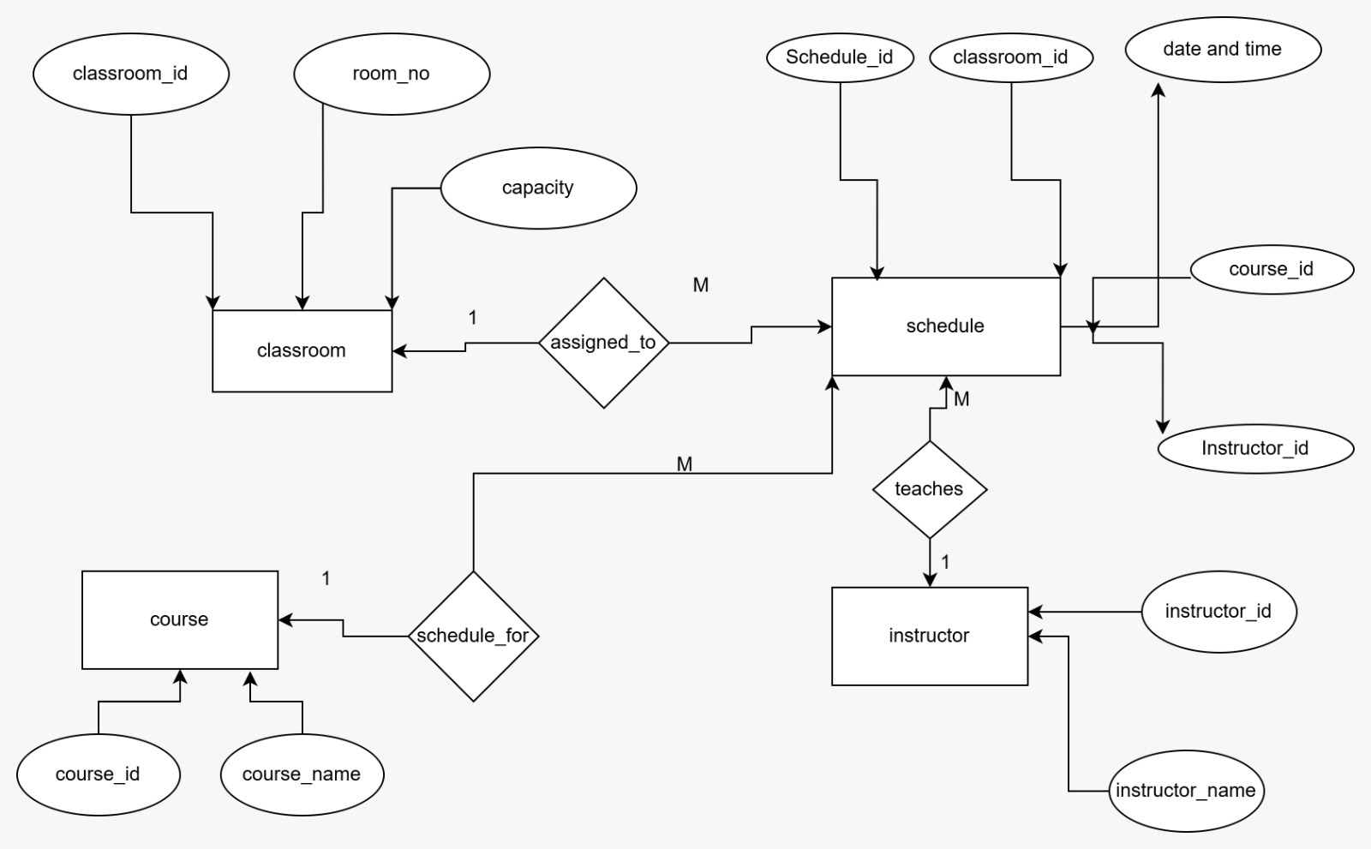
ER Diagram

Slide 6

Logical Data Model
The logical data model translates the conceptual design into a detailed structure, specifying data types and constraints for each entity. This forms the blueprint for database implementation.
Classroom
Course
Classroom_id: INT (Primary Key)
Course_id: INT (Primary Key)
Room_no: INT
Course_name: VARCHAR(50)
Capacity: INT
Schedule
Instructor
Schedule_id: INT (Primary Key)
Instructor_id: INT (Primary Key)
Classroom_id: INT (Foreign Key)
Instructor_name: VARCHAR(50)
Date_and_time: INT (Placeholder for DateTime)
Course_id: INT (Foreign Key)
Instructor_id: INT (Foreign Key)

Slide 7

Physical Model (SQL Schema)
The physical model details the actual database schema, including SQL `CREATE TABLE` statements. This ensures proper data storage and relationships, ready for deployment.
CREATE TABLE Classroom ( classroom_id INT PRIMARY KEY, room_number VARCHAR(10) NOT NULL, building_name VARCHAR(50), capacity INT NOT NULL ); CREATE TABLE Instructor ( instructor_id INT PRIMARY KEY, instructor_name VARCHAR(50) ); CREATE TABLE Course ( course_id INT PRIMARY KEY, course_name VARCHAR(50) NOT NULL, credits INT, department VARCHAR(50) ); CREATE TABLE Schedule ( schedule_id INT PRIMARY KEY, schedule_date DATE NOT NULL, time_slot VARCHAR(20) NOT NULL, classroom_id INT, instructor_id INT, course_id INT, FOREIGN KEY (classroom_id) REFERENCES Classroom(classroom_id), FOREIGN KEY (instructor_id) REFERENCES Instructor(instructor_id), FOREIGN KEY (course_id) REFERENCES Course(course_id) );

Slide 8




Data Ingestion & Testing
Initial data ingestion is critical for populating the database and verifying the schema's integrity. These sample `INSERT` statements demonstrate how data will be added to the system.
Classroom Data
INSERT INTO Classroom VALUES (1, 'C101', 'Main Building', 60);
Instructor Data
INSERT INTO Instructor VALUES (1, 'Dr. Kumar');
Course Data
INSERT INTO Course VALUES (101, 'Database Systems', 3, 'Computer Science');
Schedule Entry
INSERT INTO Schedule VALUES (1, '2026-01-23', '10:00-11:00', 1, 1, 101);

Slide 9
Query and Analytics Layer
The query and analytics layer enables powerful insights into scheduling efficiency and resource utilization. These example queries provide foundational reporting capabilities.
Retrieve All Schedules
Find Available Classrooms
Instructor Workload Analysis
SELECT * FROM Schedule;
SELECT * FROM Classroom WHERE classroom_id NOT IN (SELECT classroom_id FROM Schedule WHERE schedule_date = '2026-01-23' AND time_slot = '10:00-11:00');
SELECT instructor_id, COUNT(*) AS total_classes FROM Schedule GROUP BY instructor_id;
Classroom Usage Patterns
Popular Courses
SELECT classroom_id, COUNT(*) AS usage_count FROM Schedule GROUP BY classroom_id;
SELECT course_id, COUNT(*) AS total_classes FROM Schedule GROUP BY course_id ORDER BY total_classes DESC;

